Slide 1
The German electricity System:
Operational Challenges in a European wide coupled system
Dr. Dominik Schlipf
Bogota, 27.10.2022

Slide 2
TransnetBW at a glance
00

Slide 3
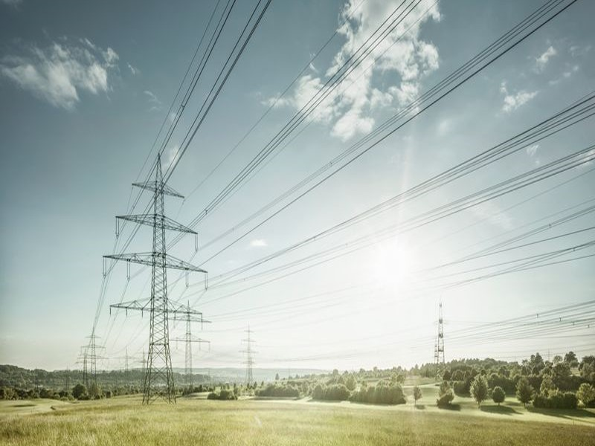
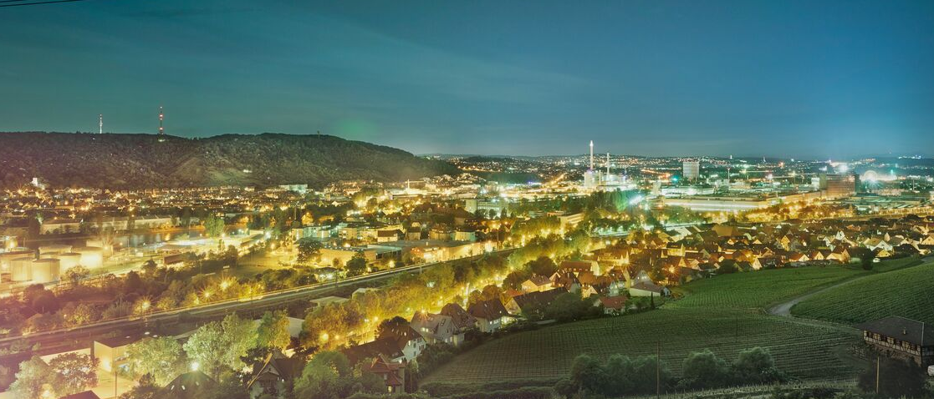
OUR GRID IS A MAJOR LIFELINE FOR RESIDENTS AND BUSINESSES
00 Company
Area served: 34,600km²
Total line length: 3,200 km (220 and 380kV)
50 substations
Peak load in Baden-Wuerttemberg: 11 GW
Annual gross electricity consumption in
Baden-Wuerttemberg: 74 TWh

Slide 4
Structure of the supply system
00 Company
European inter-
connected system
European inter-
connected system
Transmission system 380/220 kV
Redistributor
Large-area distribution system mostly 110 kV
Redistributors and municipal utilities
Regional distribution grid mostly 20 kV
Local grid mostly 0,4 kV

Slide 5
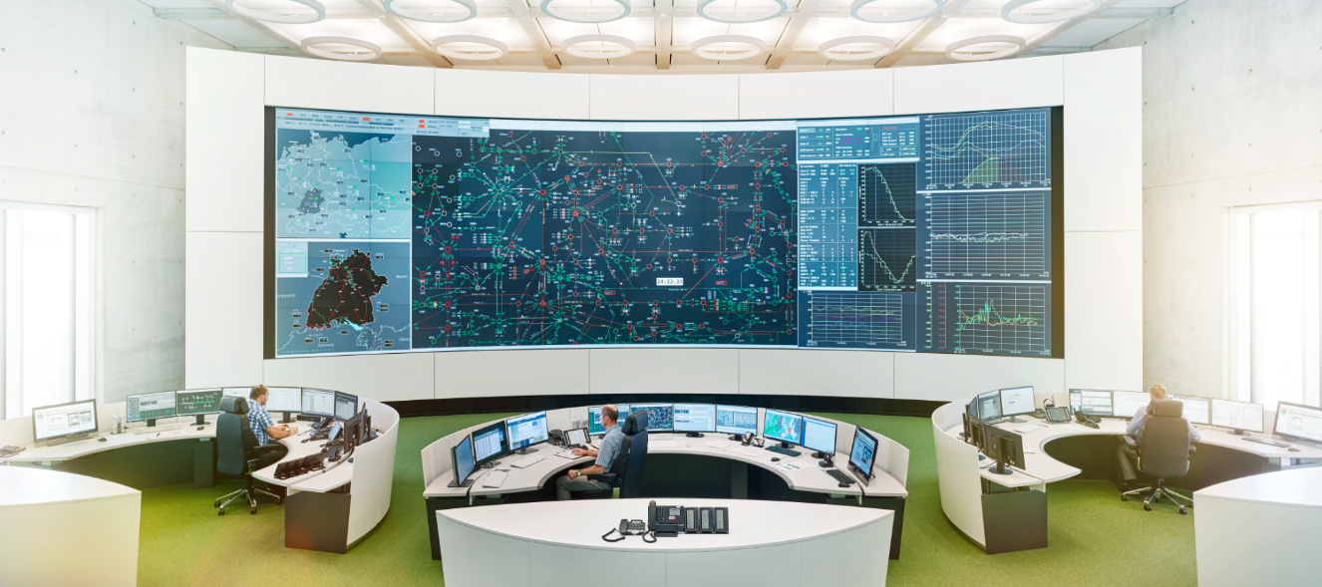
AT THE HEART OF THE TRANSMISSION GRID
00 Tasks
Operational planning
System operation
System balancing

Slide 6
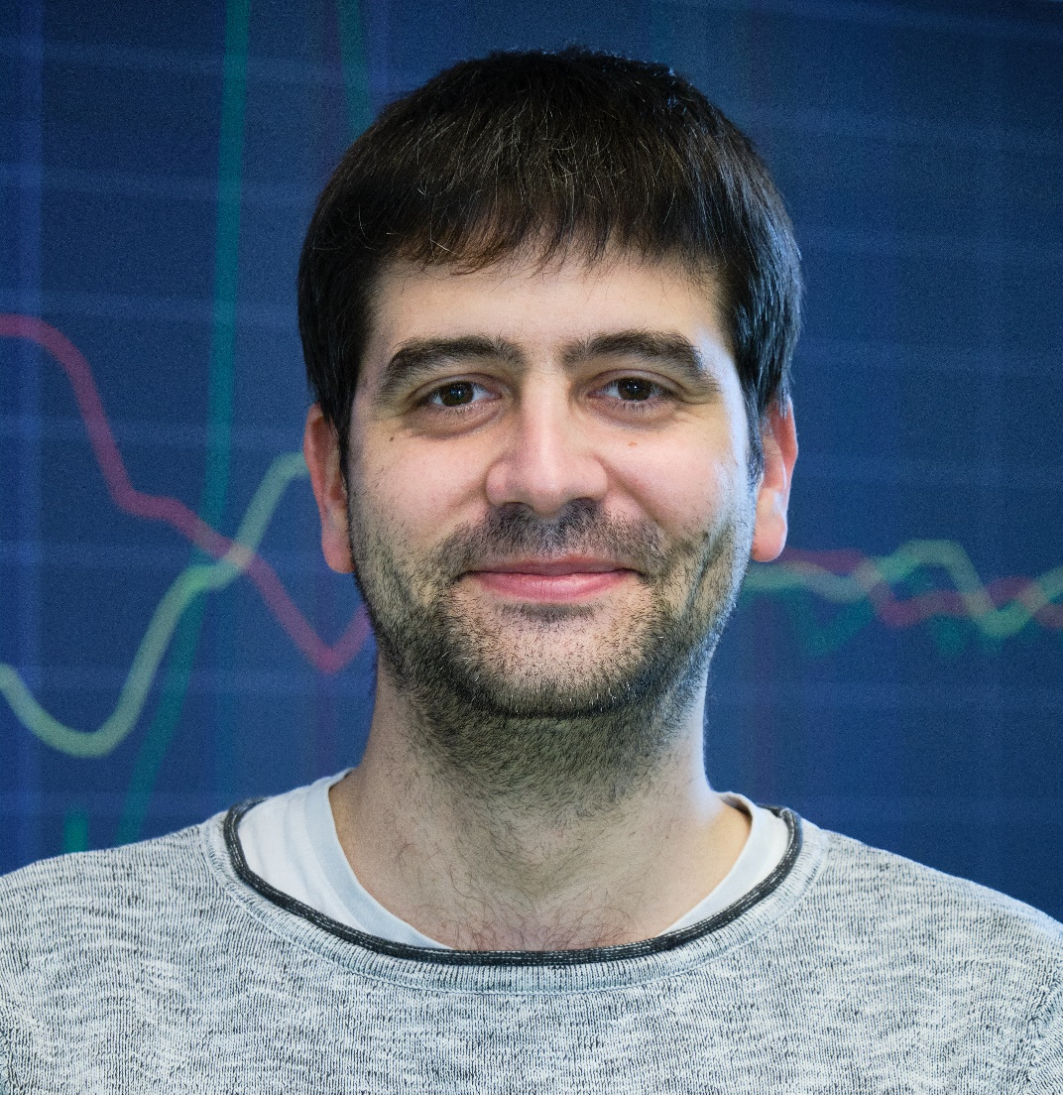
Dominik Schlipf
00 Presenter
Dr. Dominik Schlipf
Since 2019 at TransnetBW
Team leader „System Balance“
Studied Technical Cybernetics at University Stuttgart
Responsible for all systems related to system balance like
  LFC – Controller
  aFRR and mFRR procurement and activation systems
  Schedule-Management systems
  Re-Dispatch activation systems
Leading a team of 18 people (9 in 24/7 shift, 9 „backoffice“)
Active in several european projects

Slide 7
The German Energy System
01

Slide 8
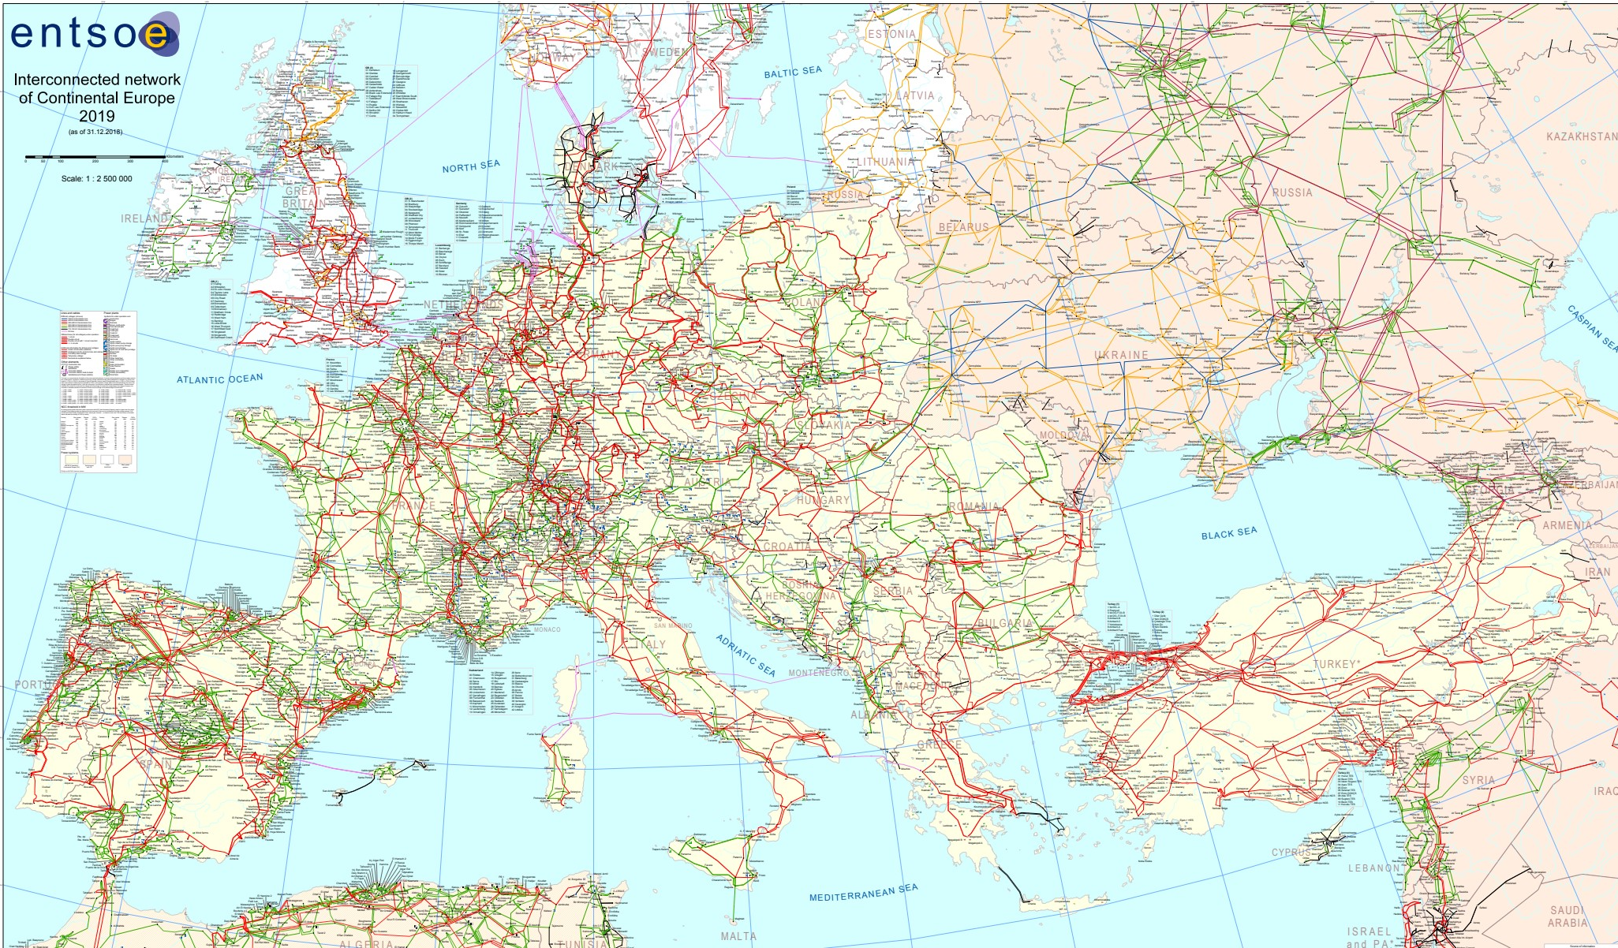
European interconnected Grid

Slide 9
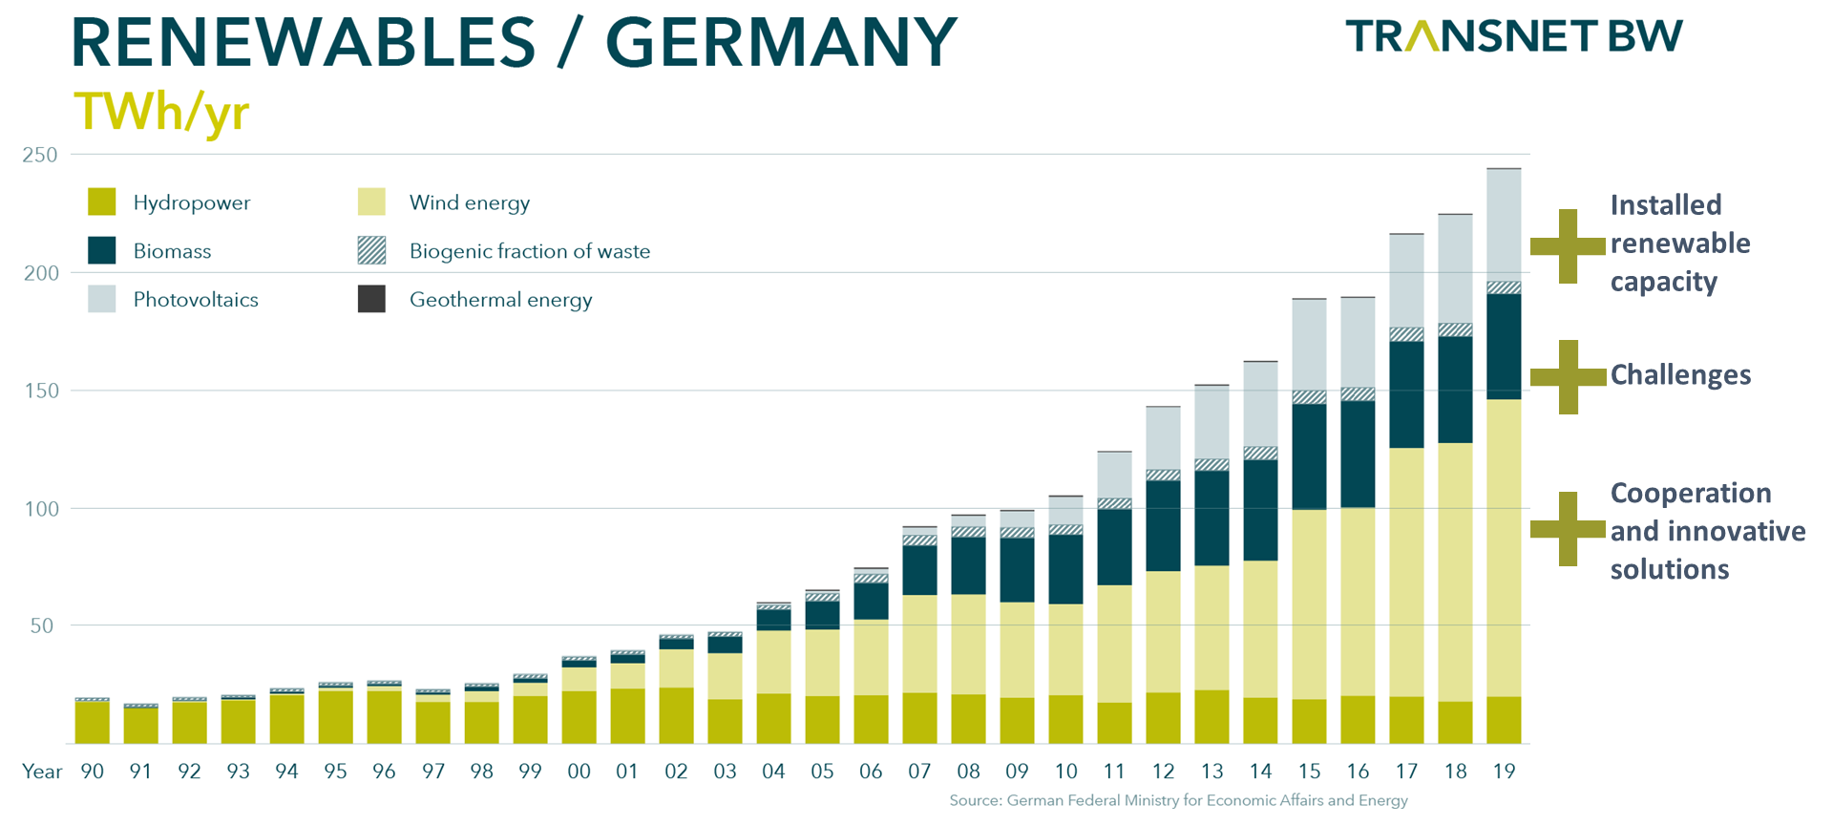
Renewables in Germany

Slide 10
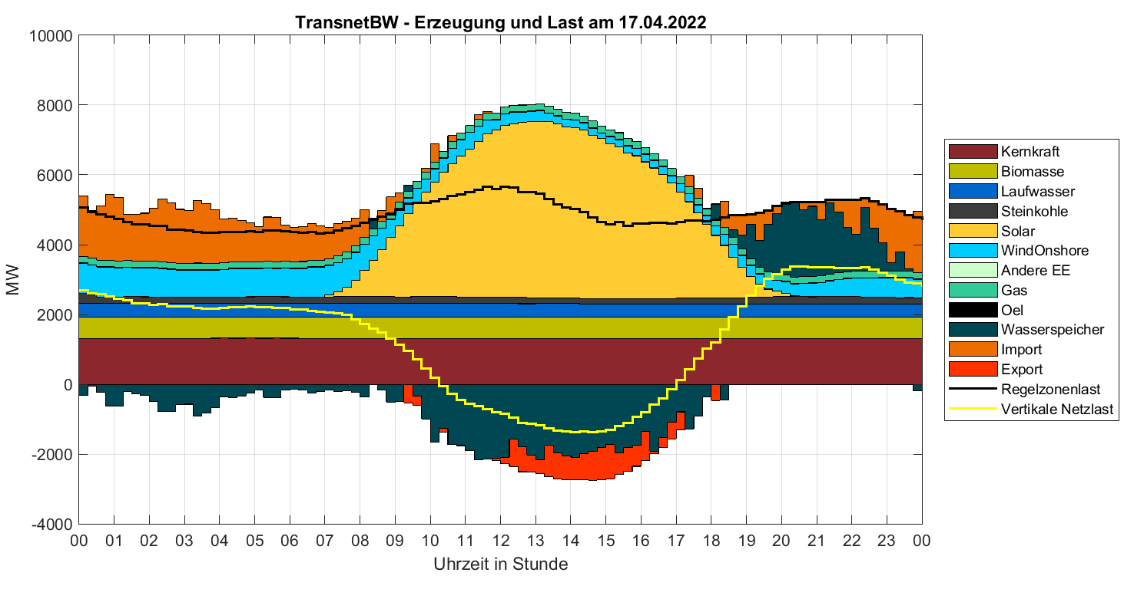
Typical situations in the TRansnetBW - LFC-Area

Slide 11
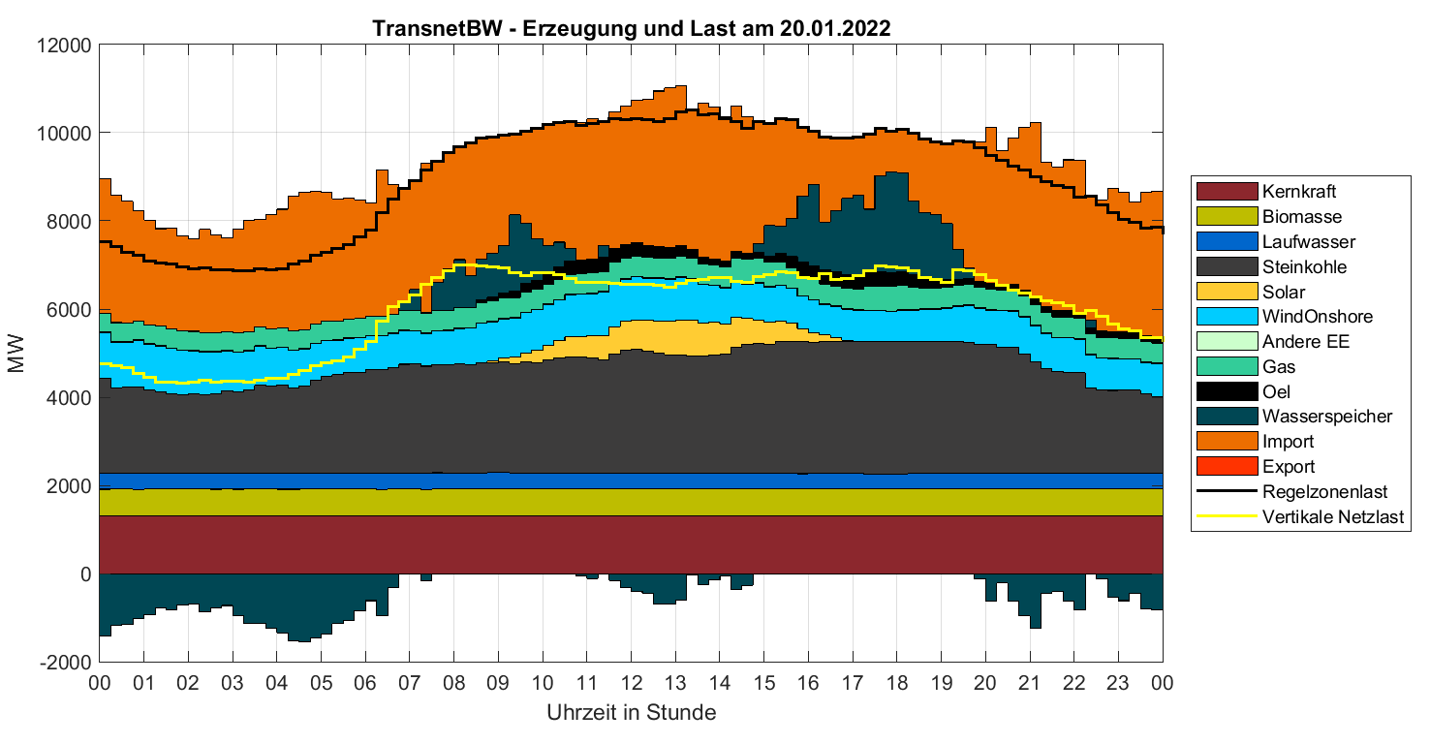
Typical situations in the TRansnetBW - LFC-Area

Slide 12
Balancing Market
02

Slide 13
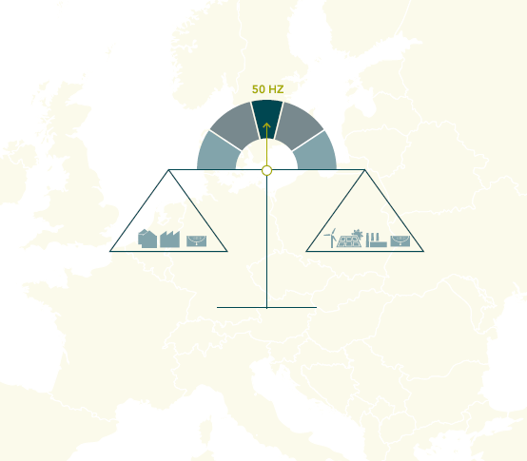
Balancing Markets
Balancing: actions and processes performed by transmission system operators (TSOs) to continuously ensure the maintenance of system frequency within a predefined stability range
Balancing process’ steps:
  TSOs dimension their need for balancing reserves
  TSOs procure the required balancing capacity
  TSOs procure balancing energy

Slide 14
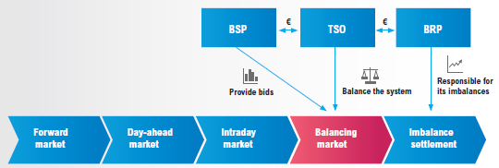
Balancing Markets
Balancing energy markets represent the institutional, commercial and operational arrangements that enable a market-based balancing of the system
Well functioning day ahead and intraday markets act as a foundation for the balancing market
TSO’s role: considering the markets’ results, to ensure that demand and supply remain balanced by operating the system close to real time
Balancing Service Providers
Transmission System Operator
Balance responsible parties
Generators, demand response and
storage facilities that can offer balancing services (capacity and/or energy) to TSOs
Source: ENTSO-E, ‘An Overview of the European Balancing Market and Electricity Balancing Guideline’, 2018.

Slide 15
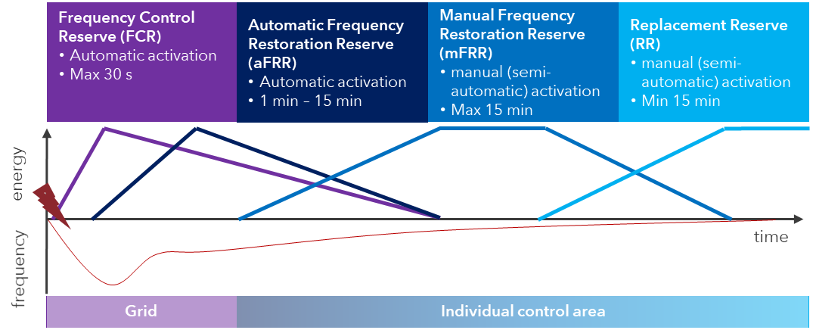
Restoring the Frequency

Slide 16
First Operational Challenge
03

Slide 17
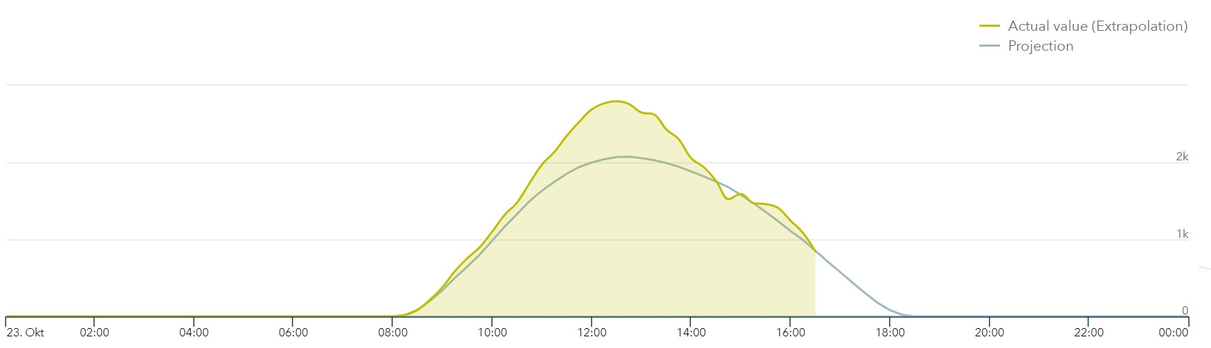
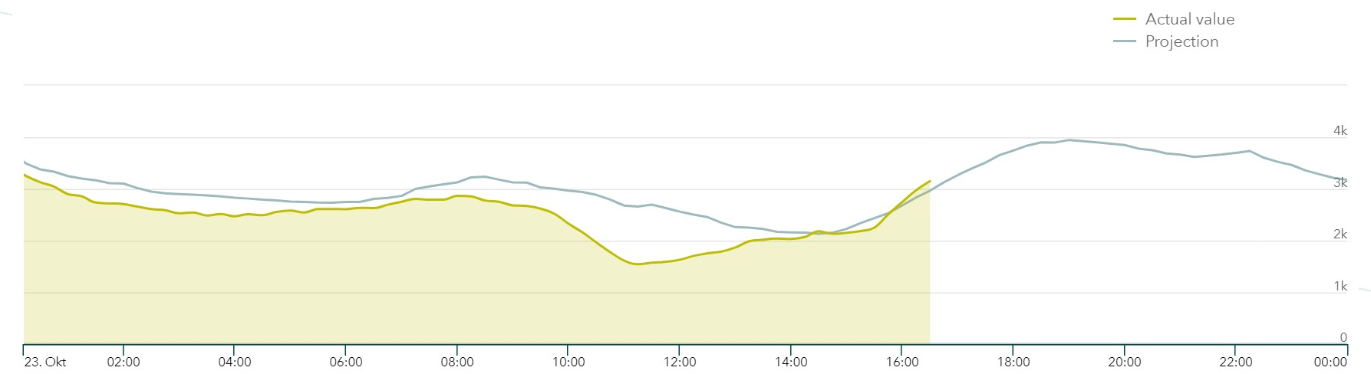
PV-Forecast Error
Most of the installed PV capacity is placed in the low voltage grid (mainly rooftop)
PV-forecast errors during autumn
Forecast errors is directly visilbe in the vertical load and is resulting in an error within the system balance

Slide 18
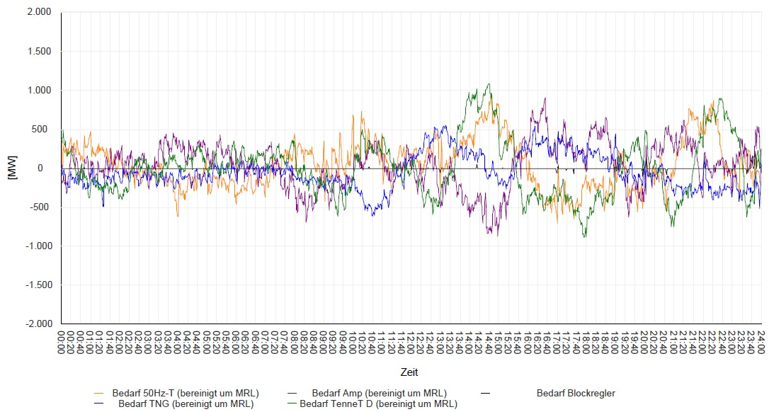
PV-Forecast Error
Most of the installed PV capacity is placed in the low voltage grid (mainly rooftop)
PV-forecast errors during autumn
Forecast errors is directly visilbe in the vertical load and is resulting in an error within the system balance
Nearly no error visible in the TransnetBW system balance
High intensive for the Balancing responsible parties to balance e.g. forecast errors using the ID market

Slide 19
German Grid Control Cooperation
04

Slide 20
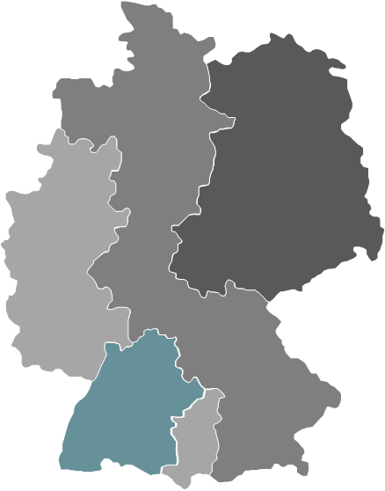
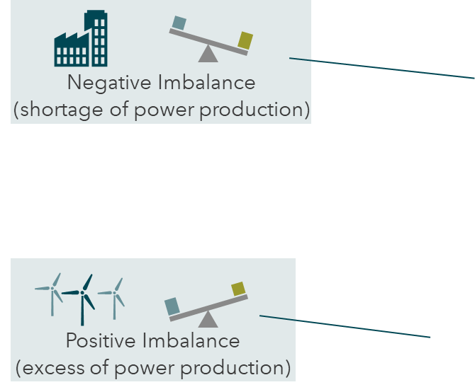
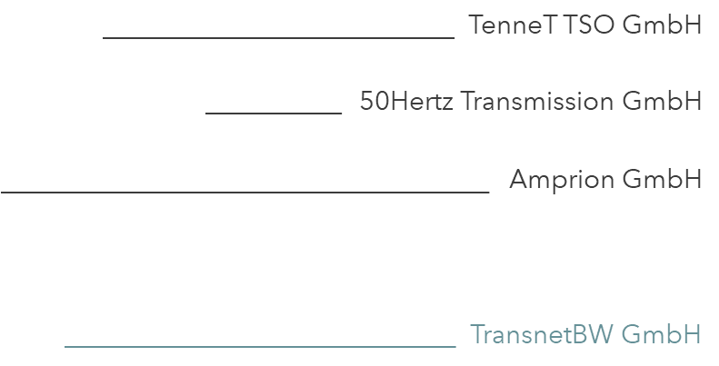
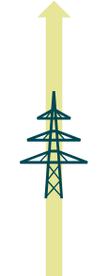
Balancing in Germany
German Grid Control Cooperation
Common activation of FRR
Common dimensioning of FRR
Optimal activation of FRR
Common operational concepts
Germany as pioneer in balancing among different control zones
Balancing occurs among 4 German TSOs since 2010

Slide 21
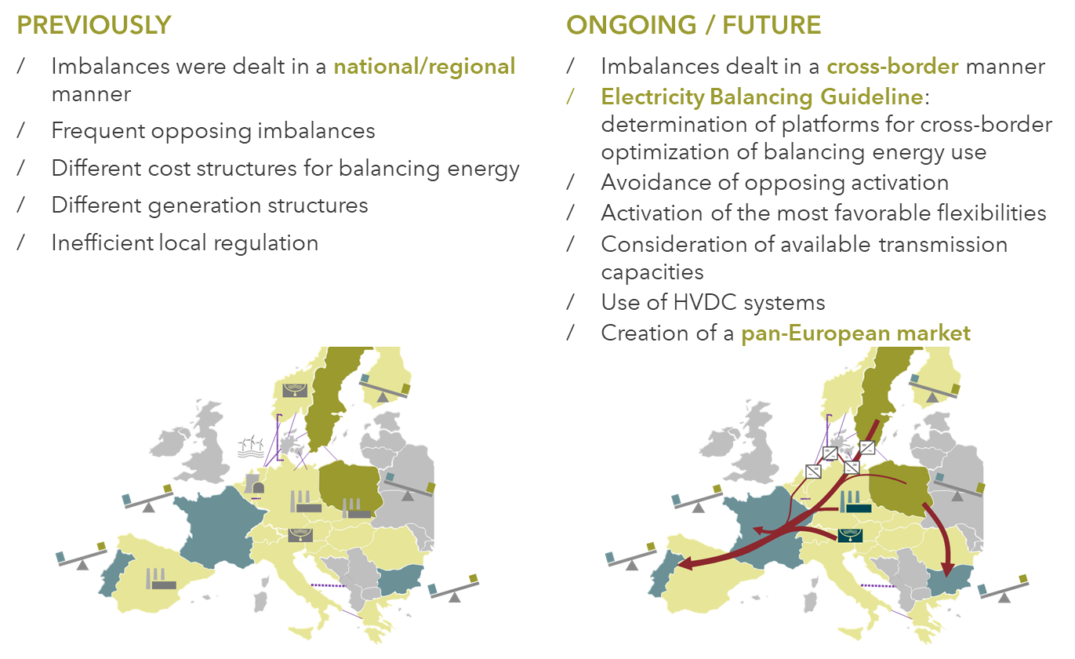
Balancing in Europe
European projects in the balancing time frame
FCR cooperation
TERRE: common activation of Replacement reserves
MARI: common/optimal activation of mFRR, hosted by Amprion
Hosted by TransnetBW:
IGCC: imbalance netting cooperation
PICASSO common/optimal activation of aFRR

Slide 22
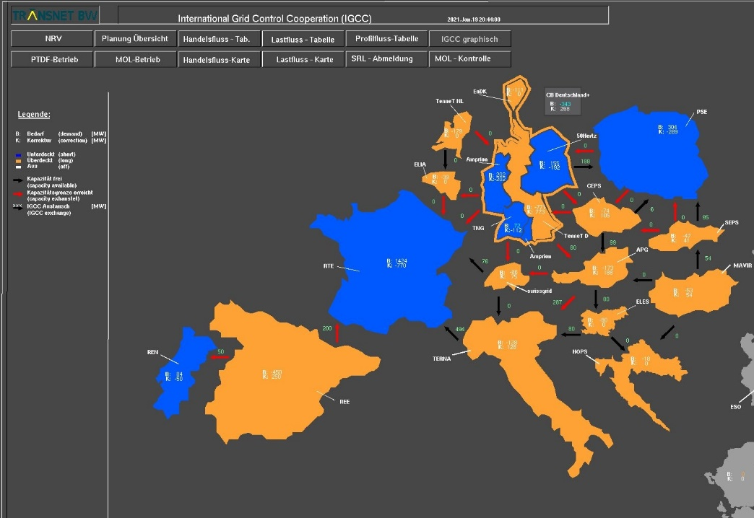
Balancing in Europe
Previously, European grid operators managed the balance within their control zones
Based on the German example, the IGCC is the European Platform for the imbalance netting process as defined by the Electricity Balancing Guideline
The IGCC:
  avoids counter-regulation and reduces balancing energy deployment → In 2020, it has led to an increase of energy savings to almost 800 GWh/month
  accommodates renewable energy forecast errors
  is a leading example of a fruitful collaboration of over half of all European TSOs
  allows a more efficient energy usage and an increase of the stability of the European electricity transmission system

Slide 23
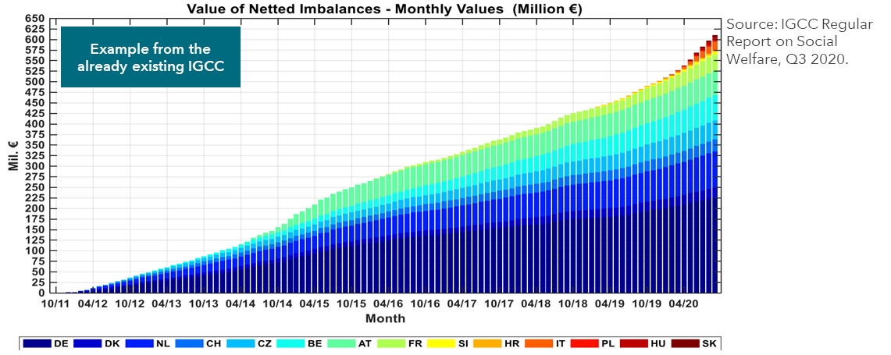
Balancing in Europe
Benefits:
  Harmonization of requirements
  Enhanced number of market participants
  Increase of economic and technical efficiency within the limits of system security
  Lower costs for electricity consumers
Example of excellent European Cooperation
Only winners: the more TSOs joining, the higher the social welfare

Slide 24
Redispatch: Combining market results with the physical reality
05

Slide 25
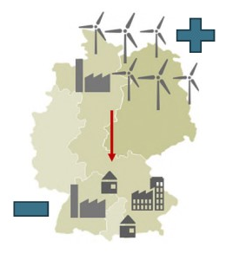
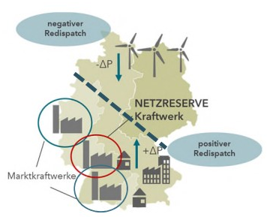
Operational Challenge
High wind potential in the north of Germany (Nordic and baltic sea), mainly offshore
High wind potential in the east of Germany
High load and main industrial consumers in the south of Germany
One „bidding“ zone in Germany -> one price for energy
Market is not „aware“ of congestions
Consequence
High load flow, „physical congestions“
Re-Dispatch: curtailment of wind in the north, activation of conventional plants in the south

Slide 26
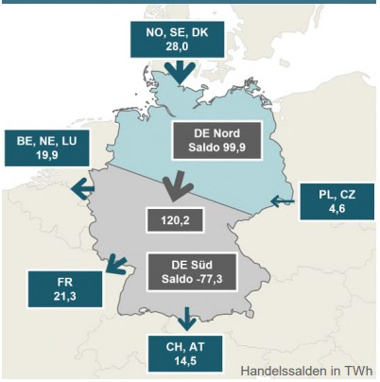
Operational Challenge
During the upcoming winter, this situation will be quite challenging in Europe and in Germany:
  Due to the war in Ukraine, the gas supply is limited (resulting in limited capacity of gas fired plants)
  Due to technical issues the nuclear fleet in France has limited capacity (resulting in additional load flows from east to west)
  Due to (possible) low water in the rivers, the coal supply in south of Germany is limited
Forecasts show quite challenging situation especially in high load / high wind scenarios.

Slide 27
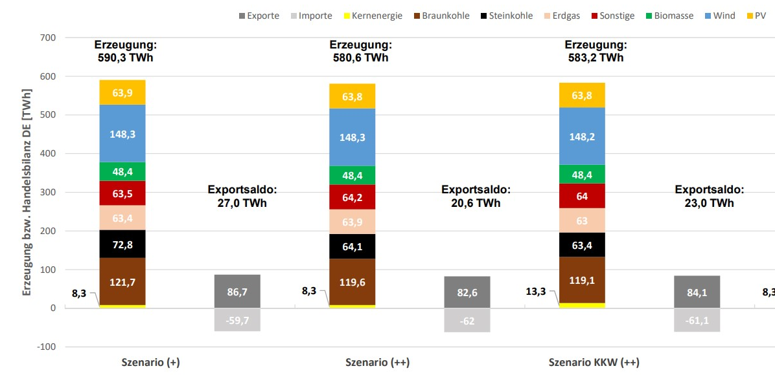
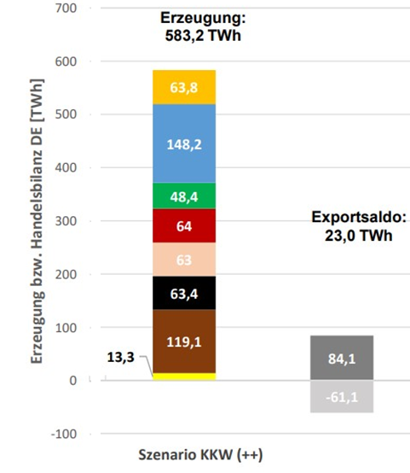
Operational Challenge
During the upcoming winter, this situation will be quite challenging in Europe and in Germany:
  Due to the war in Ukraine, the gas supply is limited (resulting in limited capacity of gas fired plants)
  Due to technical issues the nuclear fleet in France has limited capacity (resulting in additional load flows from east to west)
  Due to (possible) low water in the rivers, the coal supply in south of Germany is limited
Forecasts show quite challenging situation especially in high load / high wind scenarios.
Although gas supply is extremely limited, there is still a need to produce energy in the range of hard coal fired plants to handle such situations.

Slide 28
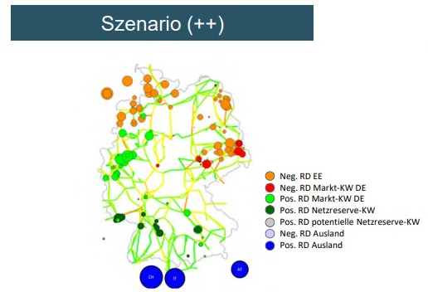
Operational Challenge
During the upcoming winter, this situation will be quite challenging in Europe and in Germany:
  Due to the war in Ukraine, the gas supply is limited (resulting in limited capacity of gas fired plants)
  Due to technical issues the nuclear fleet in France has limited capacity (resulting in additional load flows from east to west)
  Due to (possible) low water in the rivers, the coal supply in south of Germany is limited
Required Re-Dispatch:
18.2 GW of capacity is “re-dispatched”
Capacity in Germany is not sufficient, ~5 GW needs to be activated in the areas south of Germany (Switzerland, Austria, Italy)

Slide 29
Summary
06

Slide 30
summary
German Energy and Market system is based on a continiues evolution both technical and economical
Operational challenges of a system with a high share of renewables is challenging, but there are technical solution available to handle even cricital situations
As long as the evolution of the grid (additional AC lines, additional DC systems, additional systems like FACTs, etc) can‘t keep up the step of the installation of renewables, gas fired plants are an important part of the system.
Re-Dispatch is one key factor to handle such situations
Cooperations between TSOs wihtin an interconnected system are an essential part for an efficent system operation.

Slide 31
Hinweis zur Nutzung von Präsentationen:
Urheberrechte:
Diese Unterlage ist urheberrechtlich geschützt. Die Vervielfältigung, Weitergabe oder anderweitige Nutzung der Unterlage ist nur mit ausdrücklicher Zustimmung der TransnetBW GmbH gestattet.
Haftung:
Diese Unterlage wurde mit großer Sorgfalt erstellt. Die TransnetBW GmbH übernimmt keine Haftung für Aktualität, Richtigkeit und Vollständigkeit der Unterlage.

